Slide 1
SciGraph
11Feb2015 - condit@sdsc.edu
http://j.mp/SciGraph

Slide 2
Overview
NoSQL / Neo4j
SciGraph Architecture
SciGraph Use Cases

Slide 3
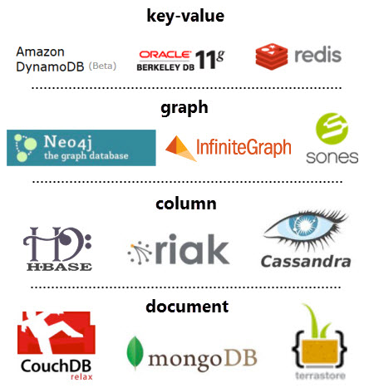
NoSQL
Not “No SQL”
but
“Not Only SQL”
or better yet:
“nonrelational databases”

Slide 4
Neo4j
Java 1.7
Schema-less
Open source friendly license
Server vs embedded
≈ 34 billion nodes and edges
High availability
Interfaces
Web interface, Gremlin, Cypher, REST, JVM
Traversals
Algorithms

Slide 5
Neo4j Drawbacks
Replication
Number crunching / aggregate global analysis
Binary data / blobs
Cypher is proprietary
Conceptual shift

Slide 6
Property Graph Data Model
title: Effective Java
author: Joshua Bloch
Book
:READ {year:2005}
:READ {year: 2009}
Person
Researcher
Person
name: Chris
title: Engineer
Developer
name: Sally
title: Specialist
:WORKS_WITH

Slide 7
Ontology Fragment
Hippocampus
has_part
CA1
CA2
CA3
CA1 Alveus
CA1 Stratum Oriens
CA1 Stratum Radiatum

Slide 8
SciGraph Goals
Store ontological data in Neo4j
Support OWL 2 semantics
Domain agnostic
Support graph operations
Support “vocabulary” operations
Support “annotation” operations
Provide basic REST services

Slide 9
What SciGraph Isn’t
Does not “round trip” ontologies
Not a magical ontology management system
Does not manage ontologies or versions
Is not a primary store of data
Does not support CRUD operations

Slide 10
Alternatives
tinkerpop sail
owlapi
jena tdb
YMMV

Slide 11






Architecture
SciGraph
Vocabulary
dipper
Annotation
OpenRefine
SciGraph processor
Graph Ops
SciGraph - REST
owlapi / SciGraph loader
golr

Slide 12
Architecture
Java 1.7
Dropwizard for REST
Bamboo jobs for service / graph deployment
One SciGraph instance per ontology “group”
The IRI is king

Slide 13
“ID”s in SciGraph
IRI
CURIE
“Fragment”
http://example.org/ont#fragment
http://example.org/ont/fragment

Slide 14
How to use SciGraph
Use SciGraph-core
Use REST services
Use graph structure / Cypher

Slide 15
SciGraph
Loader
SciGraph-core / REST services
Neo4j Graph

Slide 16
YAML Configuration
ontologyConfiguration:
graphLocation: target/monarchGraph
ontologies:
- url: http://purl.obolibrary.org/obo/upheno/monarch.owl
reasonerConfiguration:
factory: org.semanticweb.elk.owlapi.ElkReasonerFactory
addDirectInferredEdges: true
categories:
http://purl.obolibrary.org/obo/CL_0000000 : cell
http://purl.obolibrary.org/obo/UBERON_0001062 : anatomical entity
mappedProperties:
- name: label
properties:
- http://www.w3.org/2000/01/rdf-schema#label

Slide 17
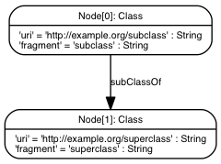
OWL Mapping Example 1
Prefix(:=<http://example.org/>) Ontology(:TestSubclassOf SubClassOf(:subclass :superclass) )

Slide 18
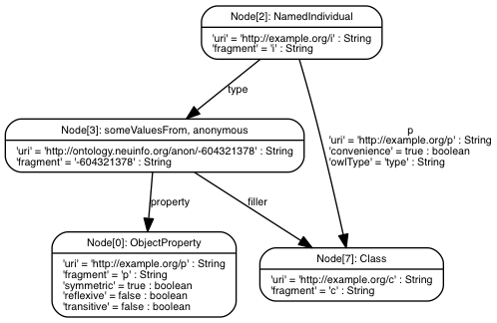
OWL Mapping Example 2
Prefix(:=<http://example.org/>) Ontology(:TestExistentialClassAssertion Declaration(ObjectProperty(:p)) ClassAssertion(
ObjectSomeValuesFrom(:p :c) :i) )
https://github.com/SciCrunch/SciGraph/wiki/Neo4jMapping

Slide 19
Mapping particulars
Annotation Assertions and Data Properties
Object Properties / Sub-Object Property
Need declarations (ie SKOS)
Does not round trip

Slide 20
Post processing
Adds indexes
Adds categories
Adds someValuesFrom edges
monarch.owl loads in < 10 minutes

Slide 21
SciGraph
Loader
SciGraph-core / REST services
Neo4j Graph

Slide 22
Vocabulary Services
/vocabulary/uri/{uri}
/vocabulary/id/{id}
/vocabulary/prefixes
/vocabulary/categories
/vocabulary/term/{term}
/vocabulary/search/{term}
/vocabulary/autocomplete/{term}
/vocabulary/suggestions/{term}

Slide 23
Annotation Services
/lexical/sentences
/lexical/chunks
/lexical/entities
/annotations
/annotations/entities
/annotations/complete

Slide 24
Graph Services
/graph/relationship_types
/graph/{id}
/graph/neighbors/{id}
json-bbop, graphml, graphson, gml, jpeg, png

Slide 25
SciGraph
Loader
SciGraph-core / REST services
Neo4j Graph

Slide 26
Cypher
[MATCH WHERE] [OPTIONAL MATCH WHERE] RETURN [ORDER BY] [SKIP] [LIMIT]
http://neo4j.com/docs/2.1/cypher-refcard/

Slide 27
Cypher
Describe what you want to find - not how to get it.
Describe it with ASCII art:
MATCH
(company)<-[:WORKS_FOR]-(me:Person{name:'chris'})
RETURN
company, me
([variable][:label/relationship] [{properties}])

Slide 28
Biological Graph Pattern
OMIM
Panther
DO
Disease 1
Human Gene 1
Ortholog Gene 1
subClassOf
hasPhenotype
orthologousTo
Biogrid
Neurodegenerative Disease
interactsWith
interactsWith
OMIM
Panther
subClassOf
Disease 2
Human Gene 2
Ortholog Gene 2
hasPhenotype
orthologousTo
What diseases are linked to genes that interact via orthology?
Notes:
Query construction
Edge pattern removal
Really linking across heterogeneous data sources

Slide 29
Biological Cypher Query
START disease = node:node_auto_index(fragment='DOID_1289')
MATCH
(disease)<-[:subClassOf*]-(d1)<-[:RO_0002200]-(hg1)-[:orthologous]-(mg1),
(disease)<-[:subClassOf*]-(d2)<-[:RO_0002200]-(hg2)-[:orthologous]-(mg2),
(hg1)-[:interactsWith]-(hg2),
(mg1)-[:interactsWith]-(mg2)
WHERE d1.id > d2.id
RETURN mg1, hg1, d1, mg2, hg2, d2
What diseases are linked to genes that interact via orthology?
Notes:
A bit of a simplification - note that interactsWith includes all sub types of interaction (or really any configuration)

Slide 30
Biological Graph Pattern
Abnormal Phenotype
hasPhenotype
Chromosome
Disease
isSubsequenceOf
hasPhenotype
Gene
Genes on each chromosome linked to abnormalities
Notes:
Query construction
Edge pattern removal
Really linking across heterogeneous data sources

Slide 31
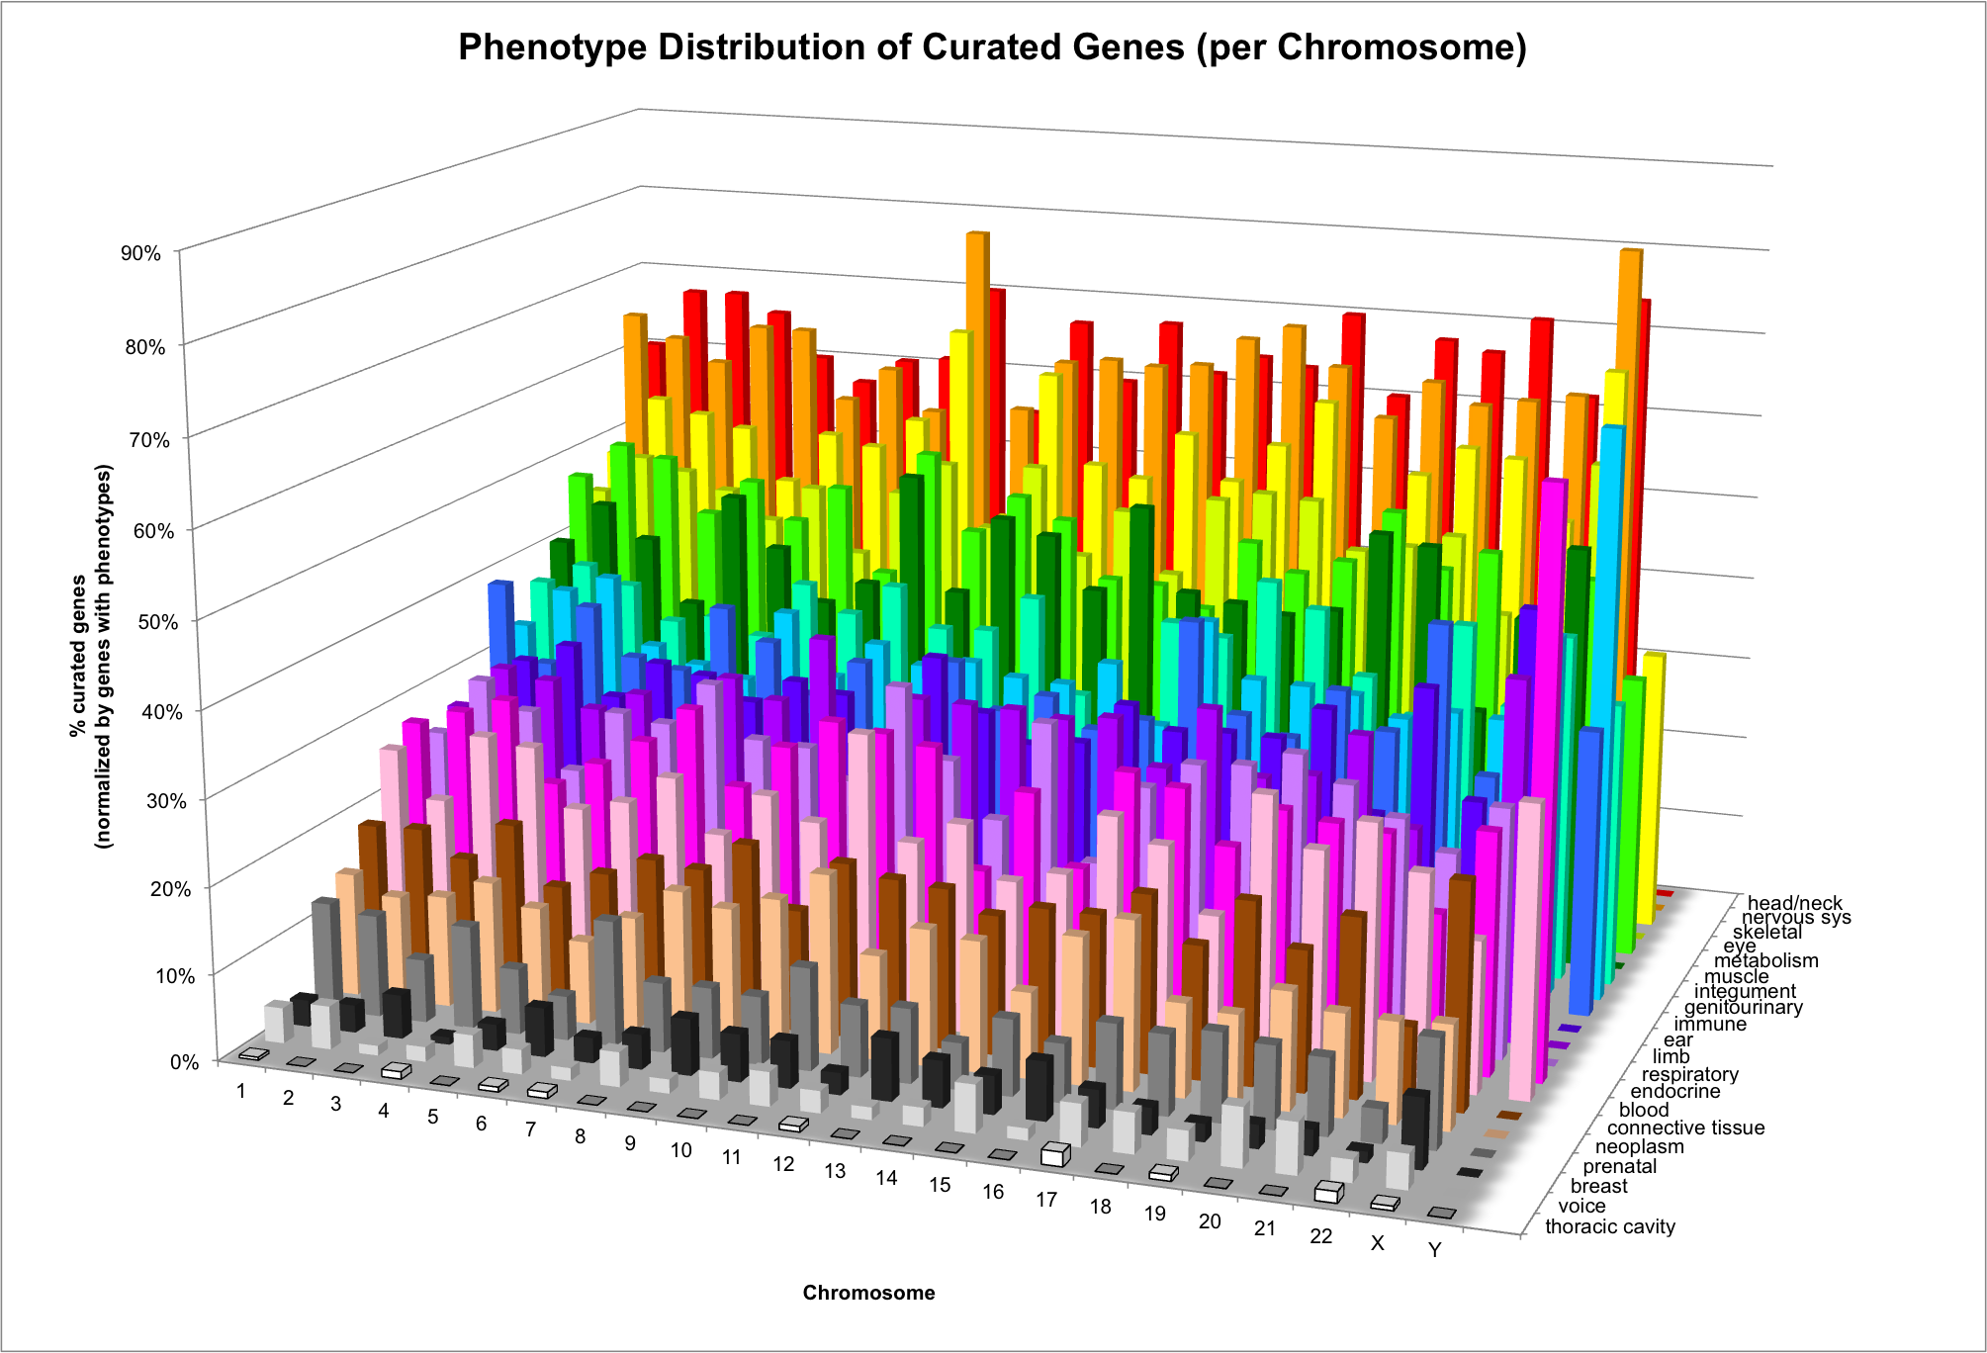

Slide 32
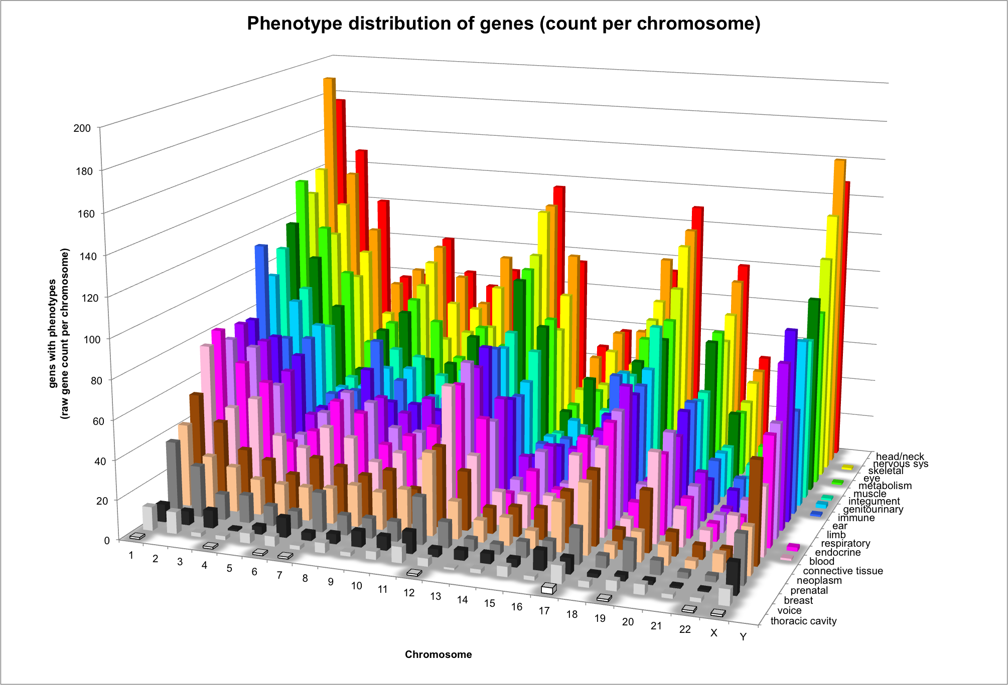
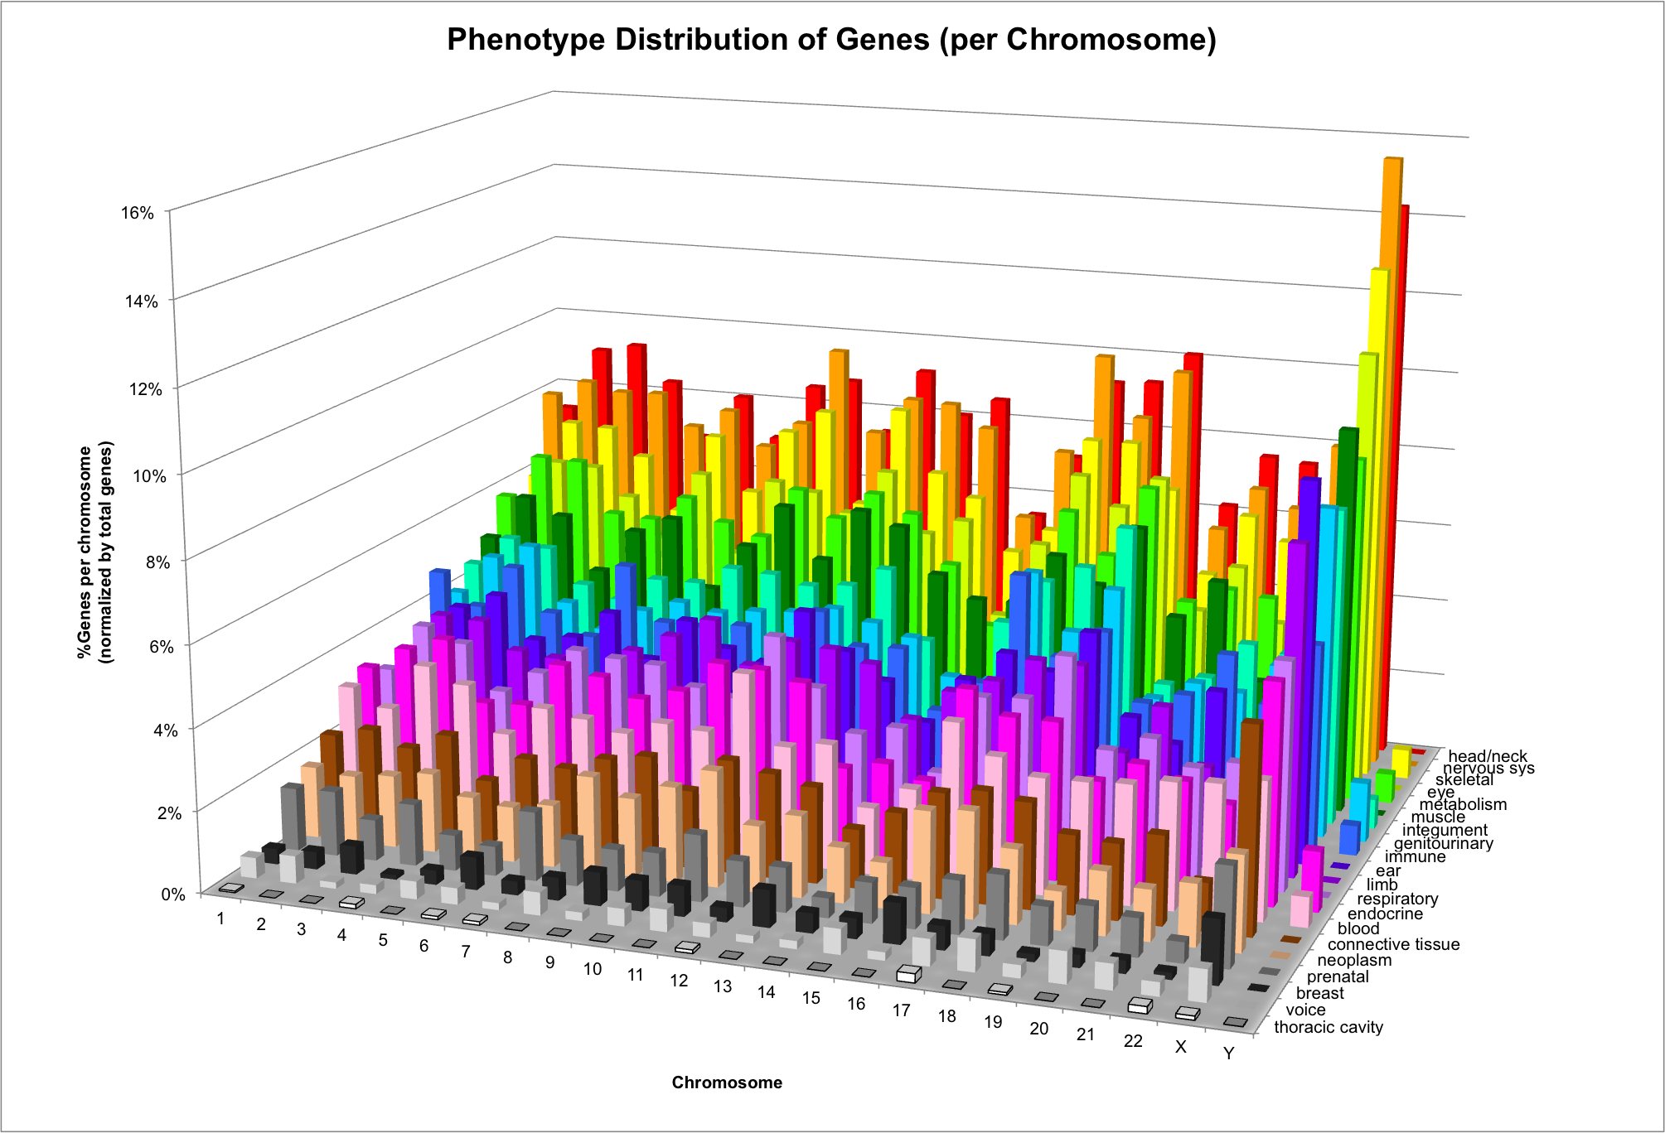
Phenotype Distribution

Slide 33
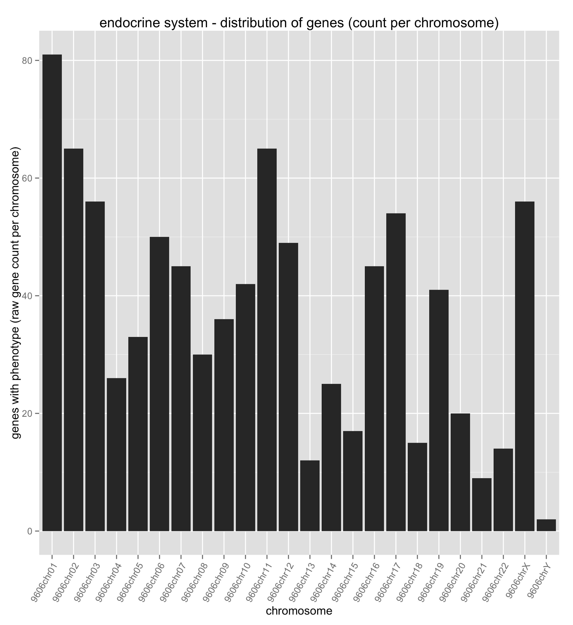
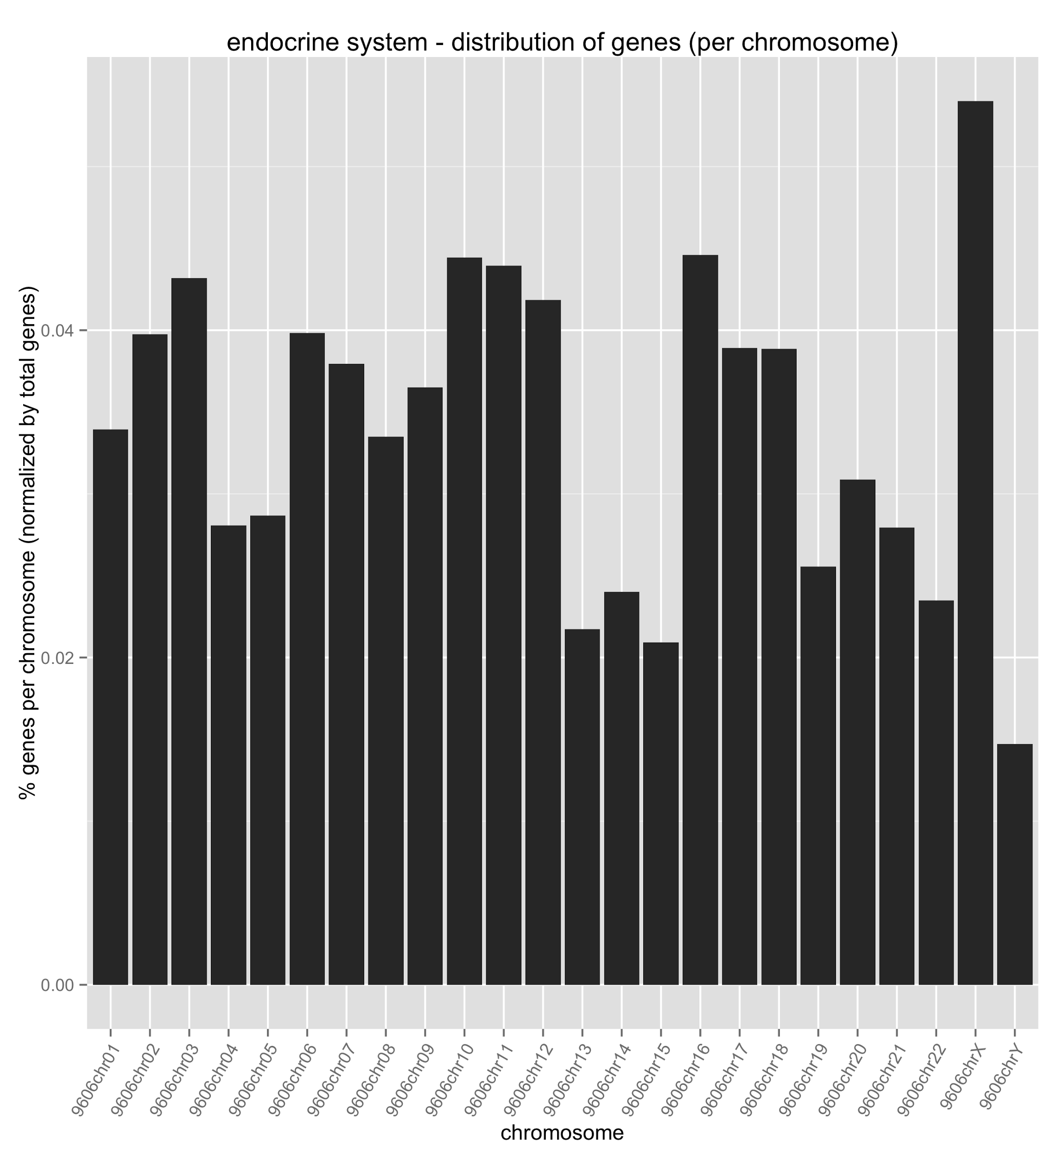
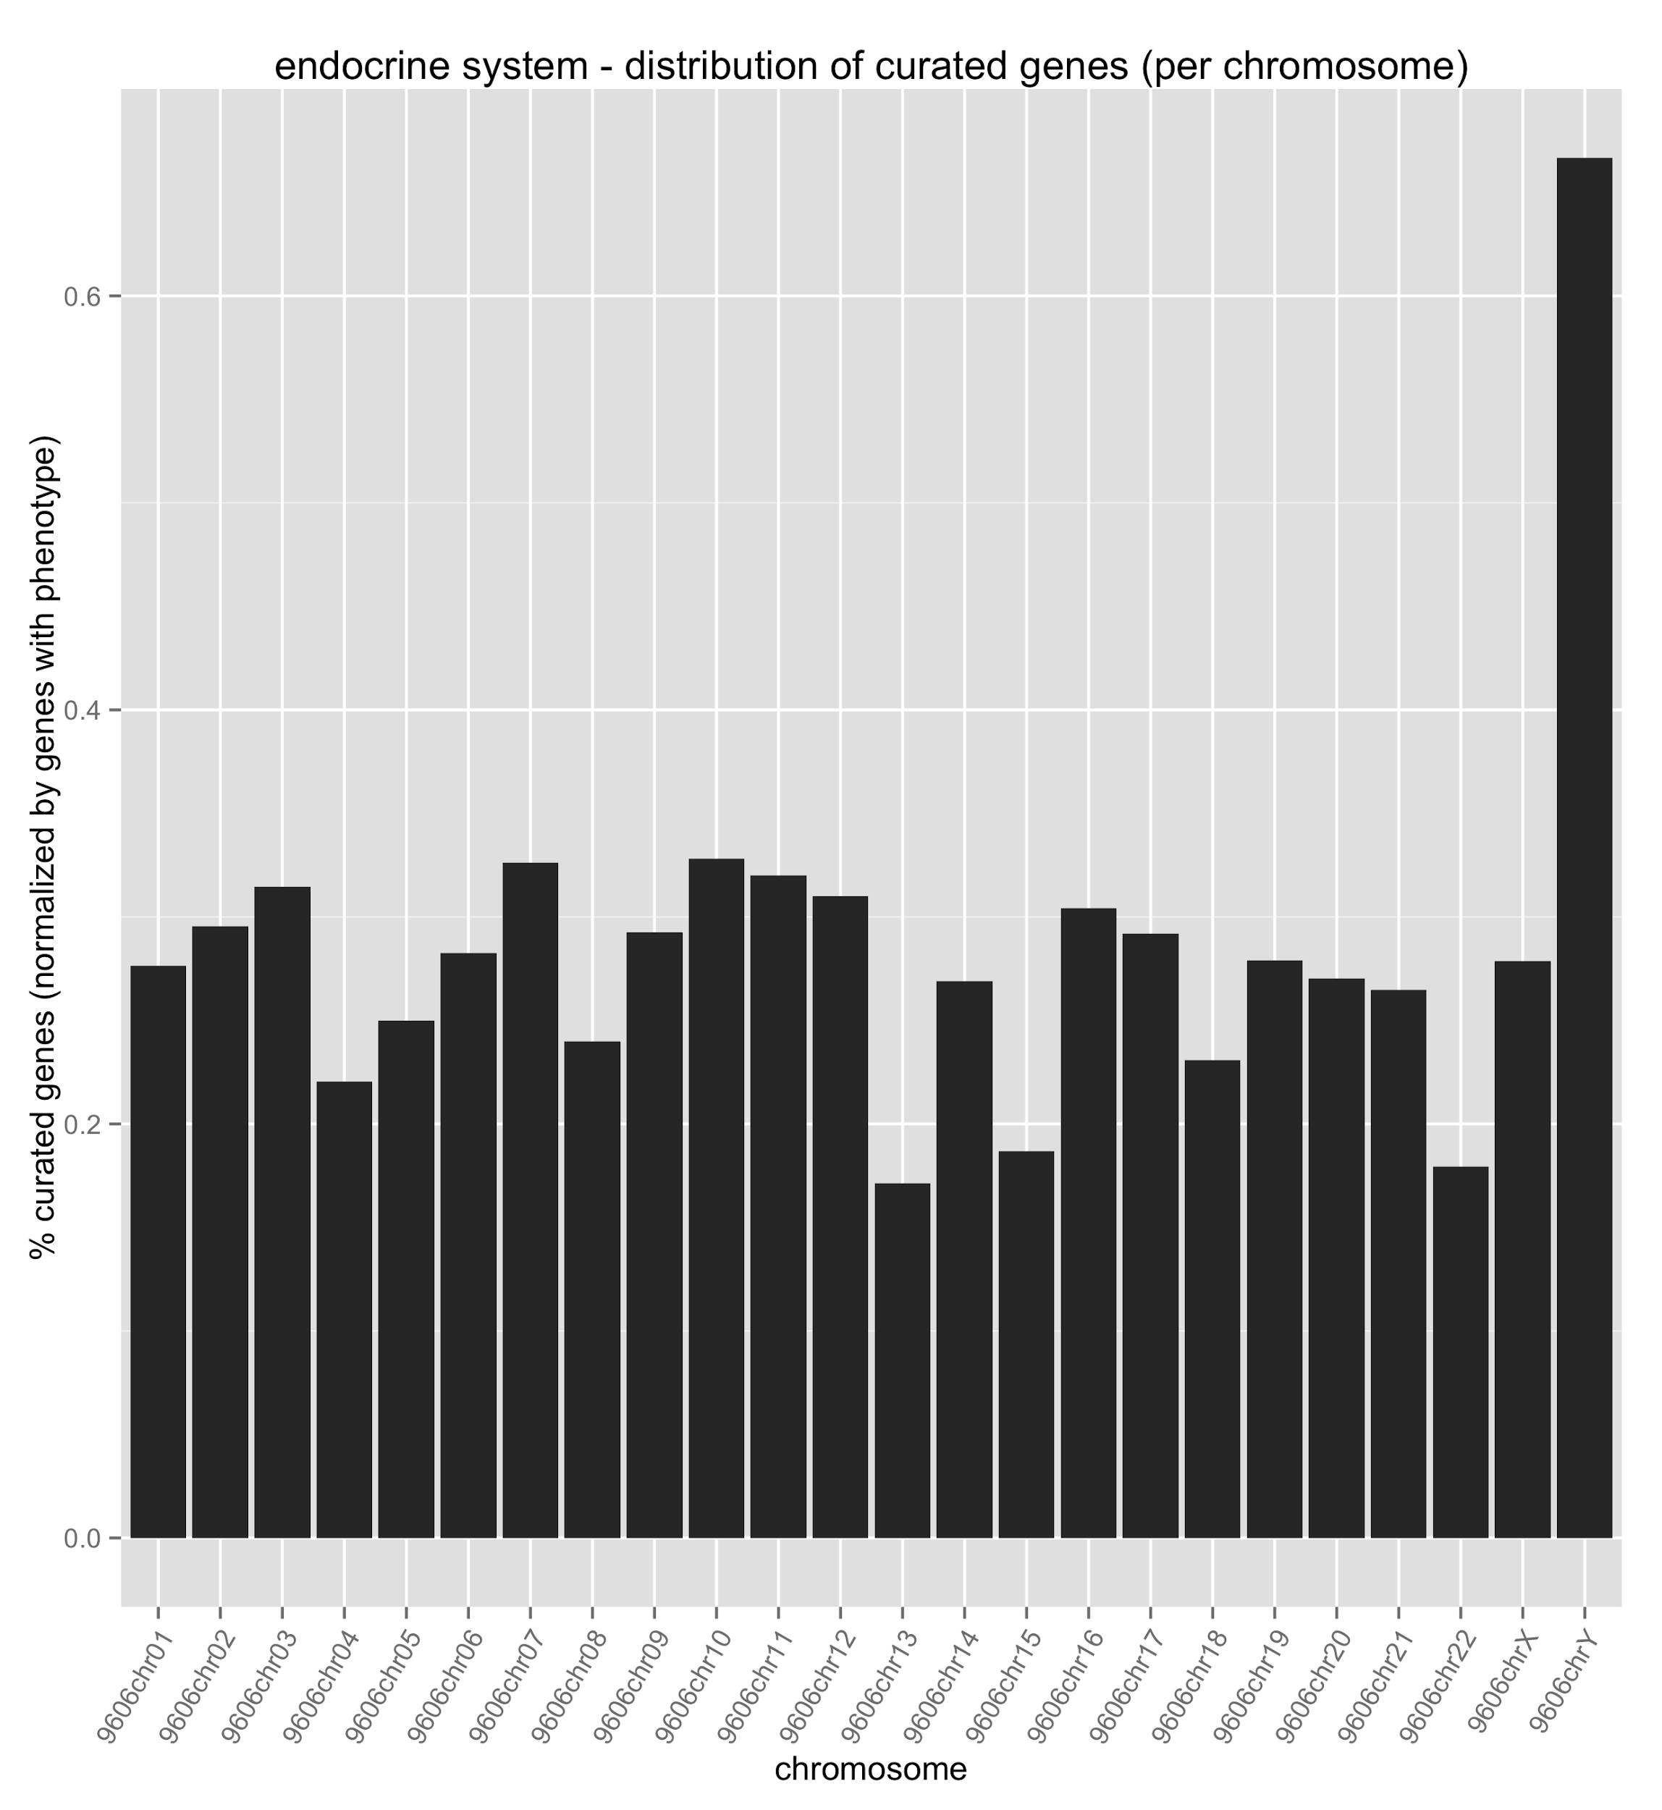
Endocrine System Abnormalities

Slide 34
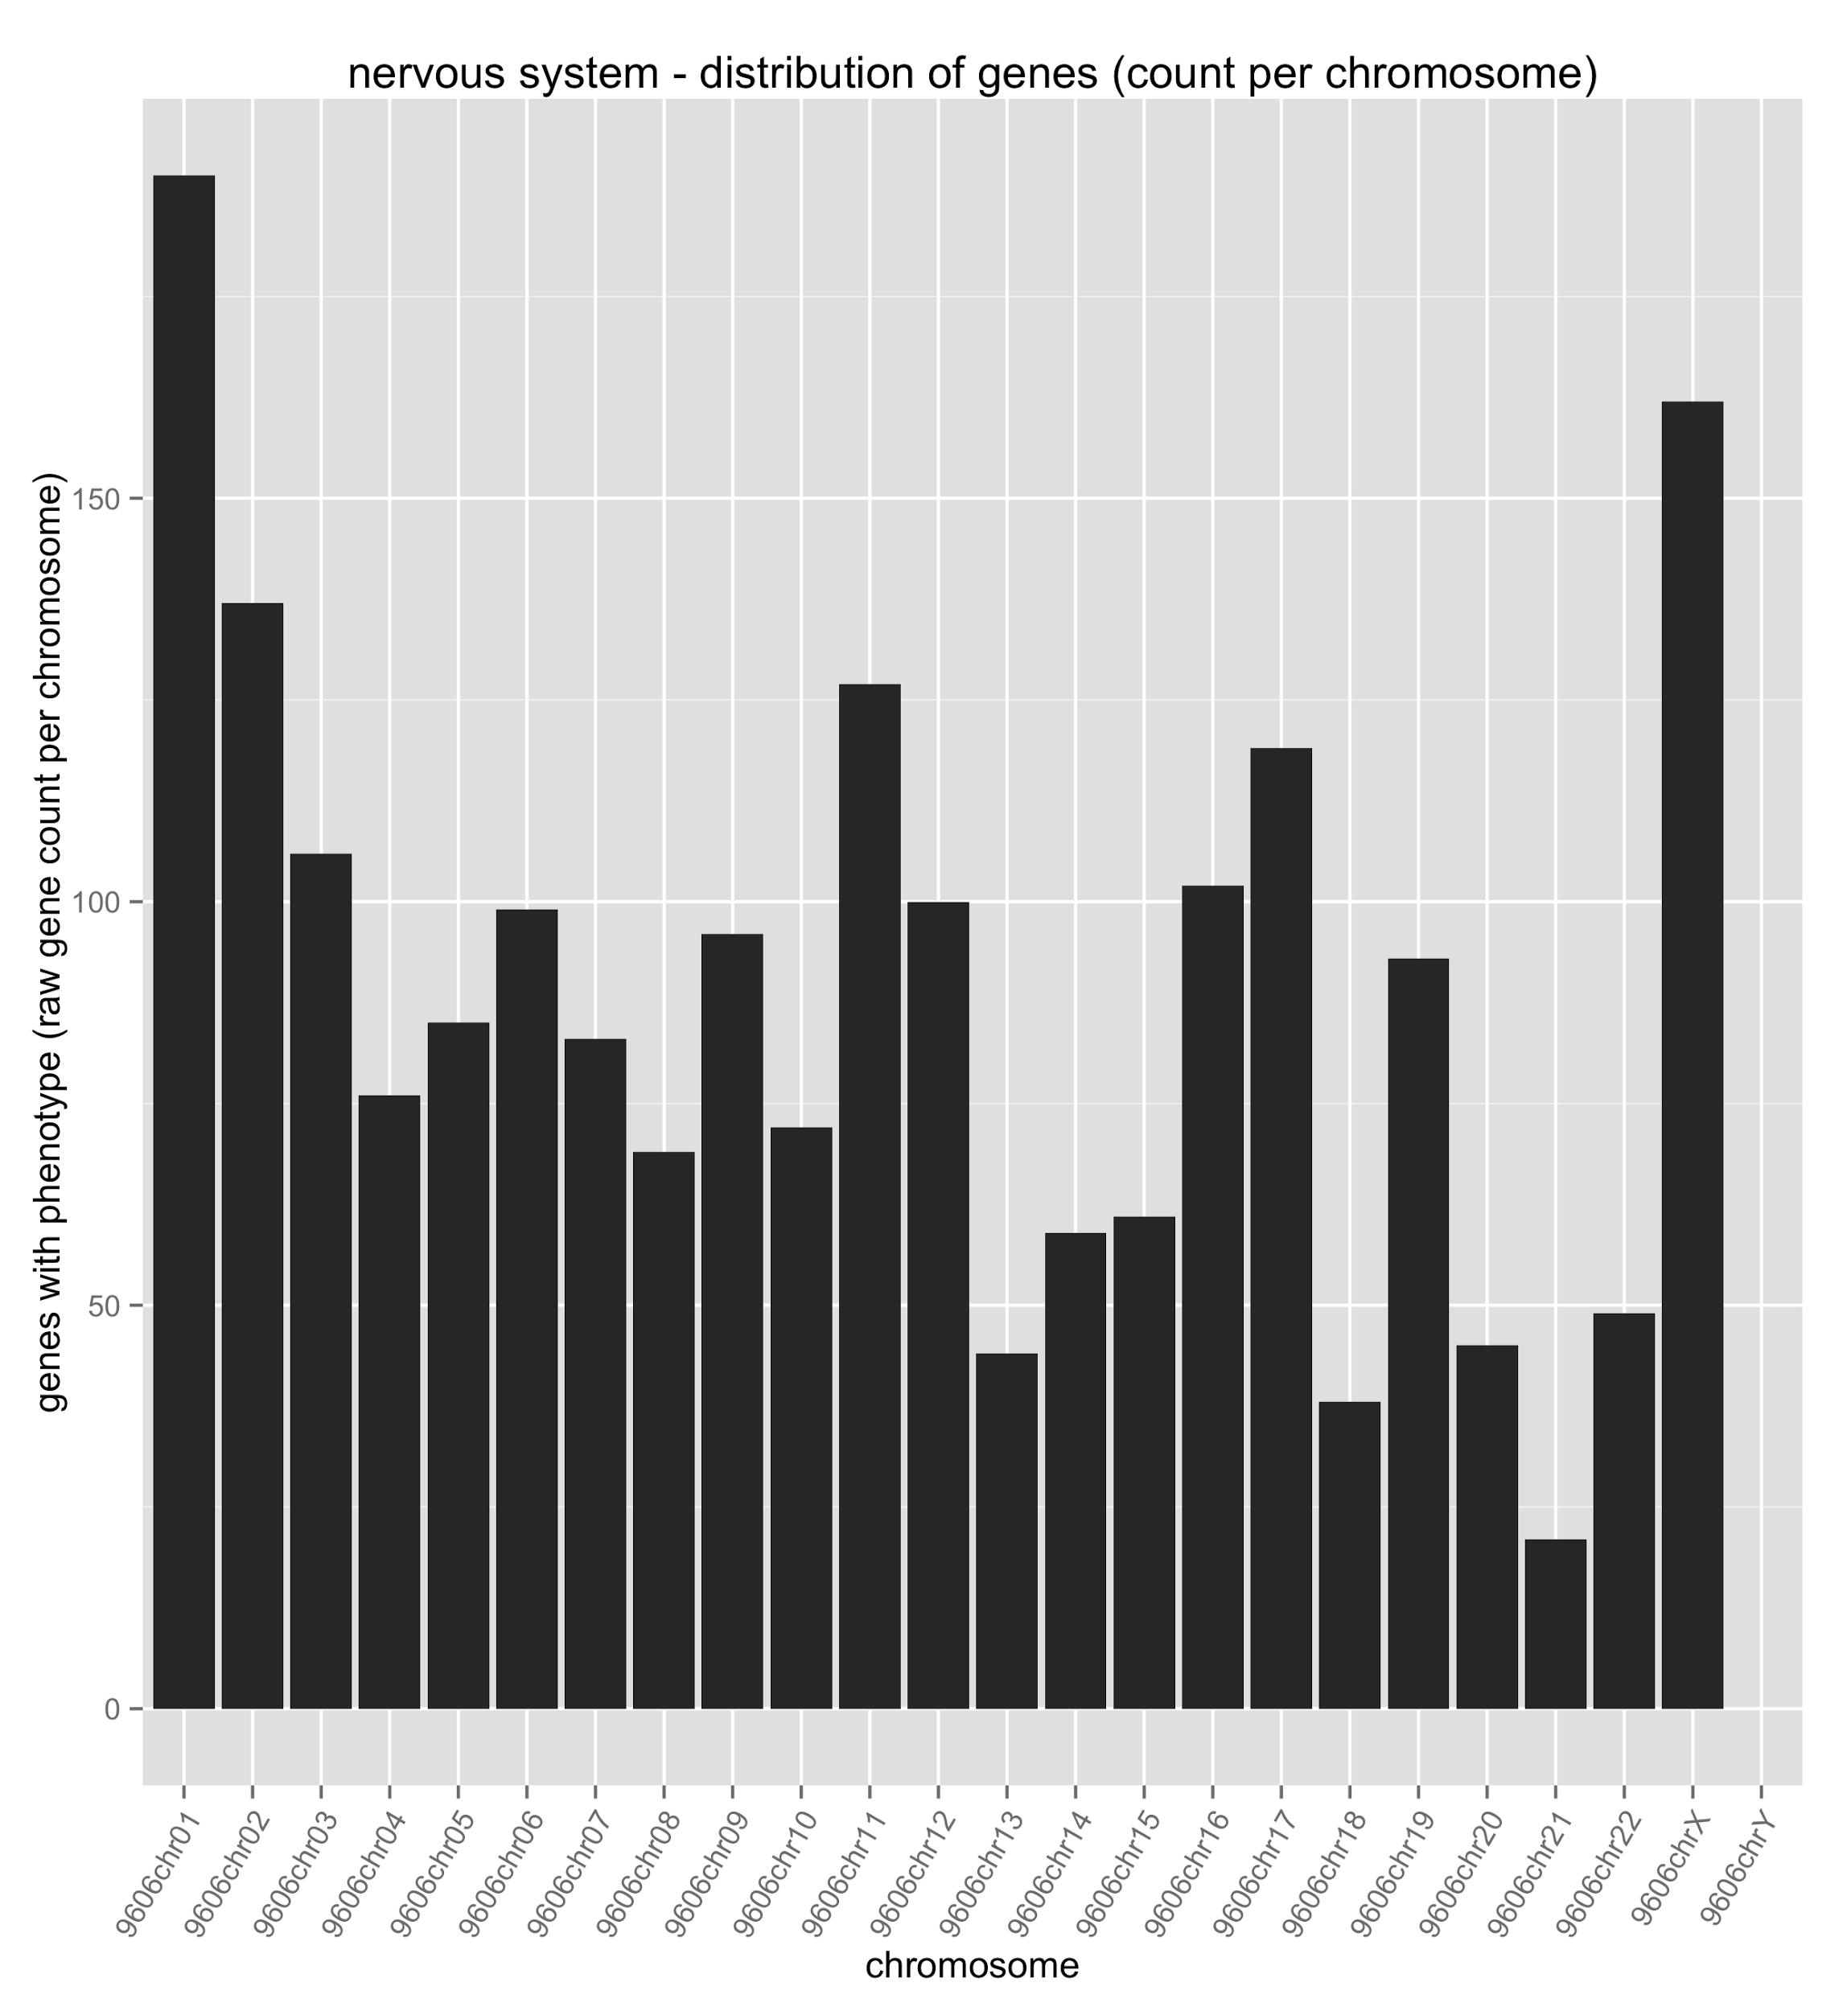
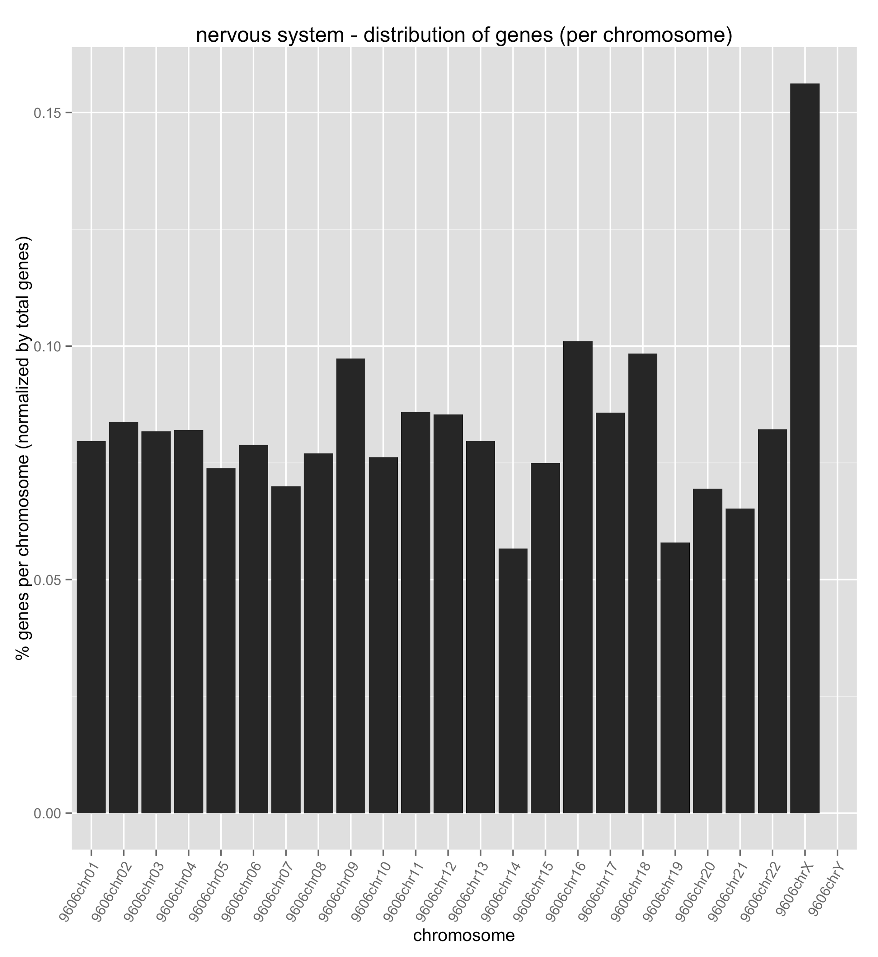
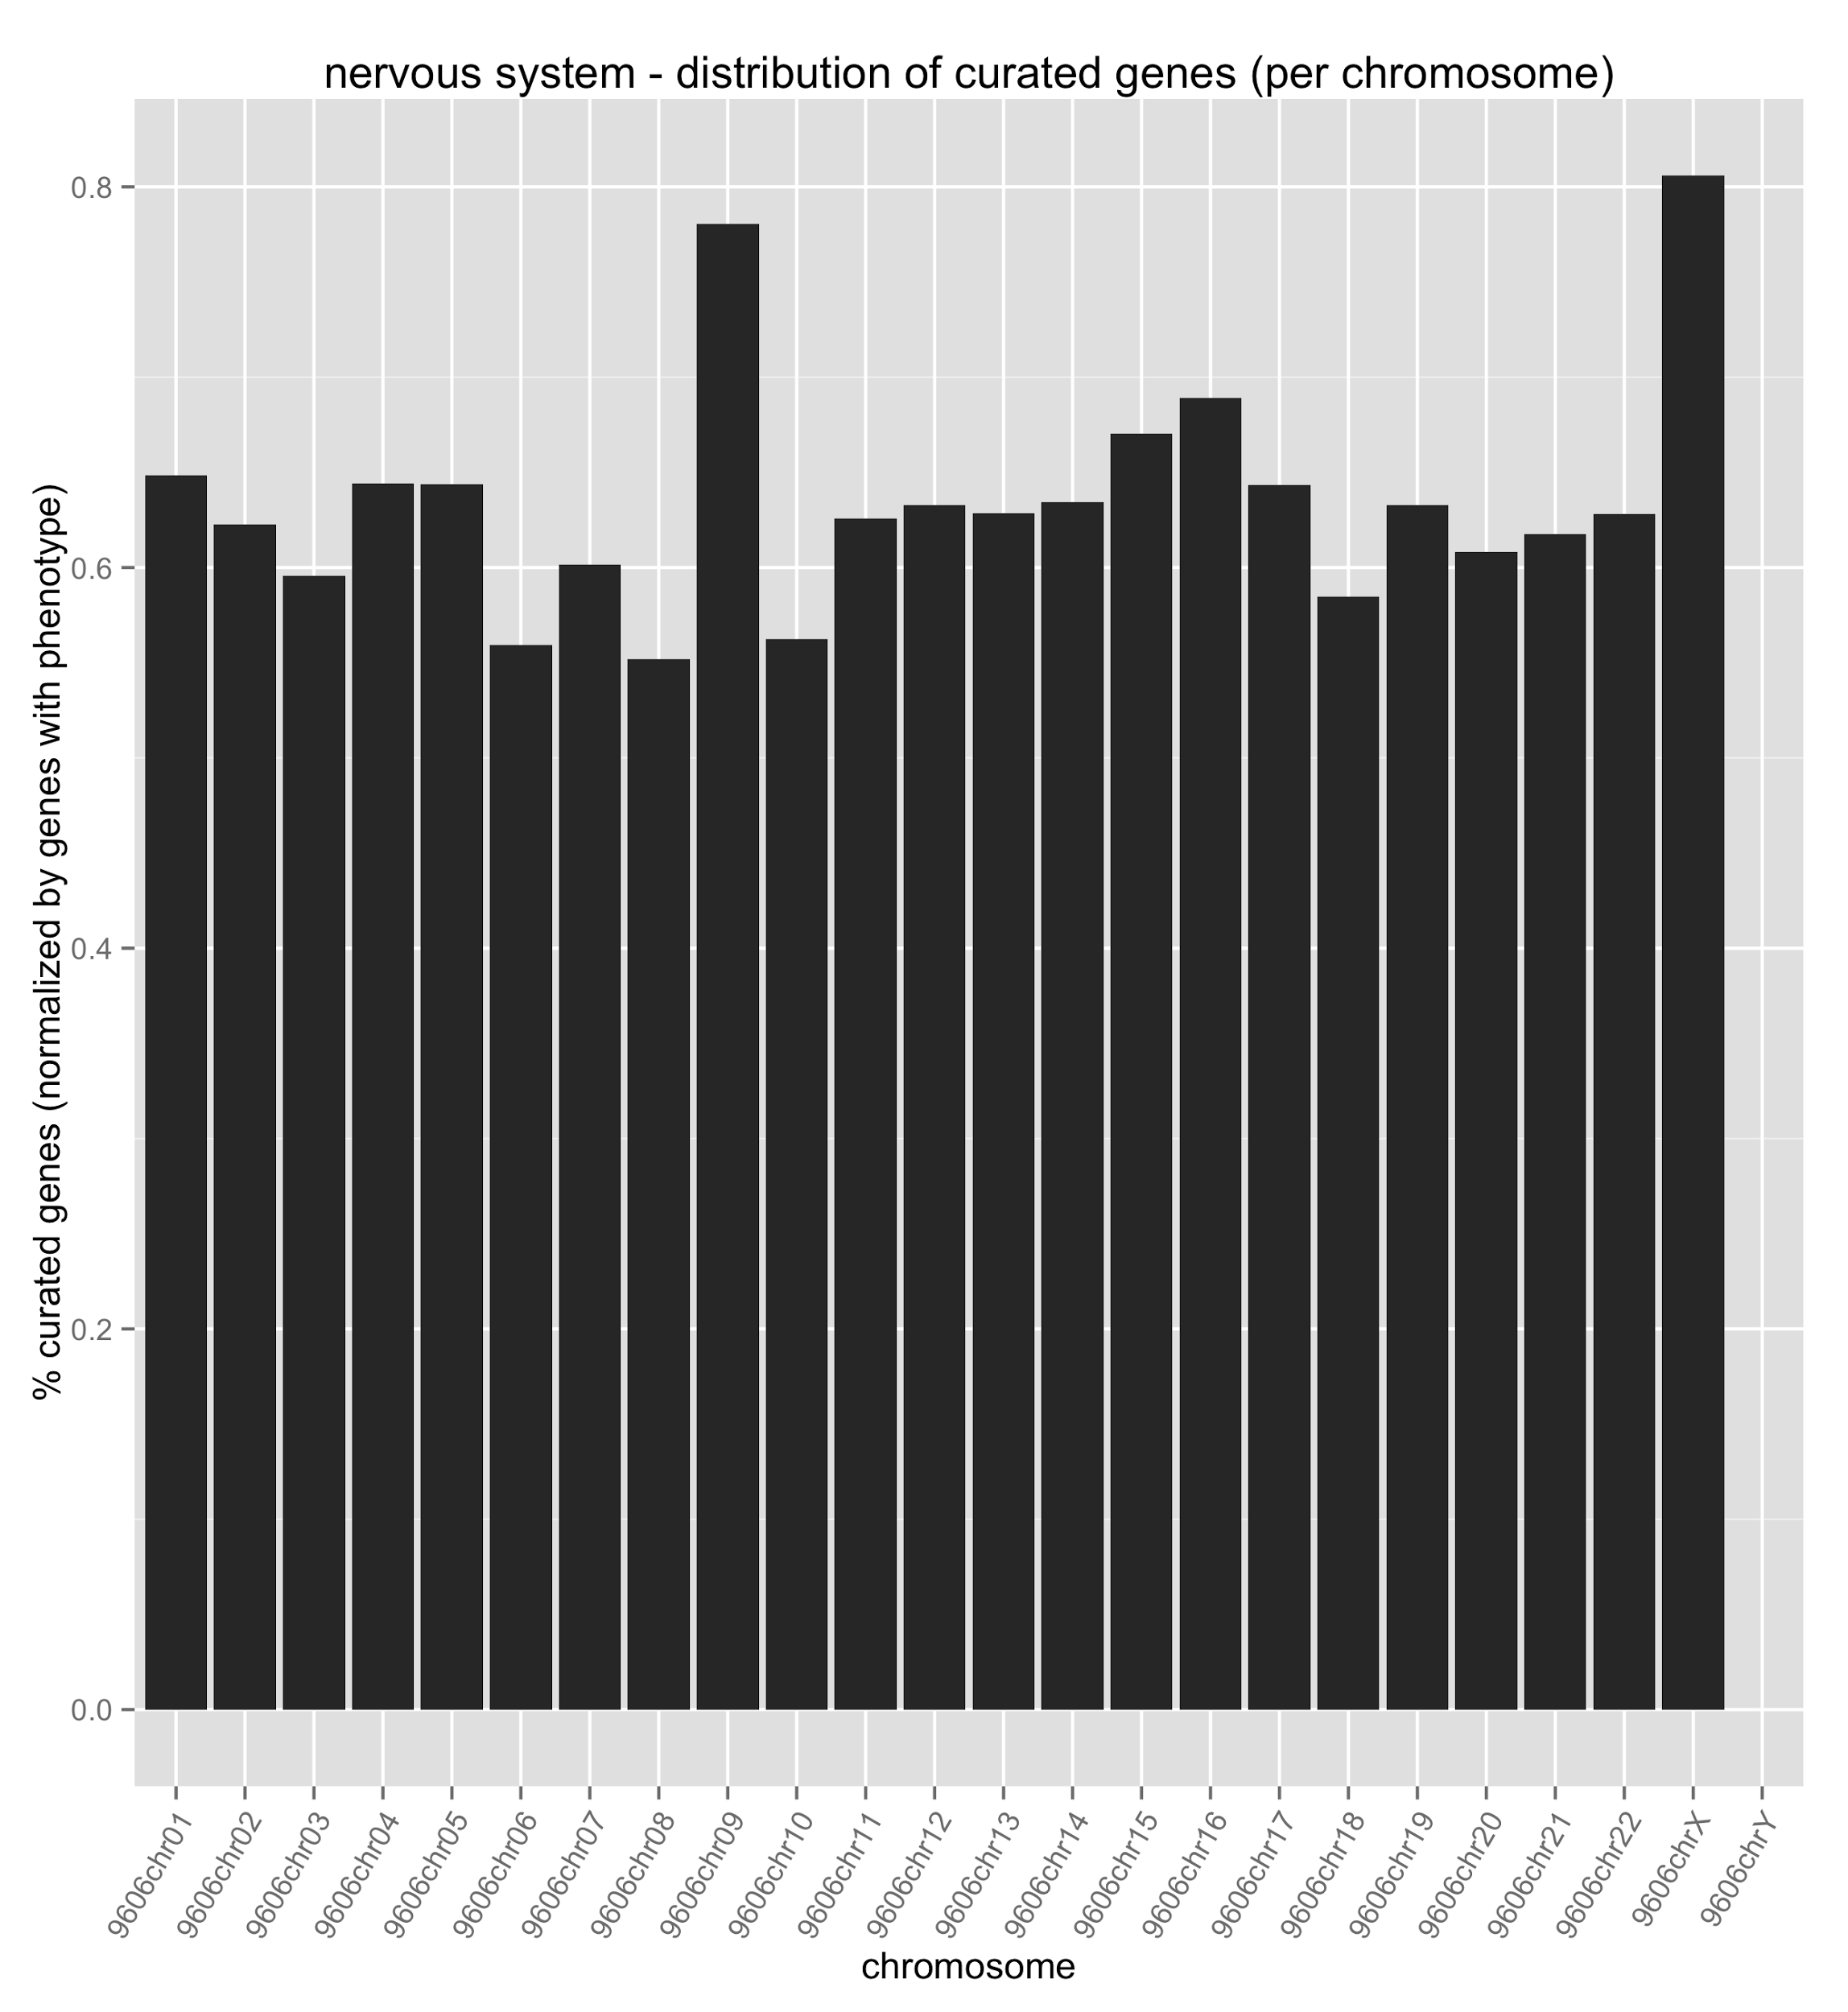
Nervous System Abnormalities

Slide 35
Stay tuned...
Query templates
More data, faster
Dipper / golr work
Live graph updates

Slide 36
Resources
http://j.mp/SciGraph
https://github.com/SciCrunch/SciGraph
http://neo4j.com/
http://neo4j.com/graphacademy/online-course/
http://geoffrey.crbs.ucsd.edu:9000/scigraph/docs/

